Slide 1
Predicting Sales Prices of Apartments in Daegu: A Regression Modeling Approach
Achmad Rizky Akbar

Slide 2
Table of Contents
Business Problem Understanding
Data Understanding and Exploratory Data Analysis
Data Preprocessing
Modeling
Conclusion
Recommendations

Slide 3
Introduction
Daegu is as a bustling metropolis in South Korea
Population, economic significance, and cultural richness of the city
Growth and development of Daegu's real estate market

Slide 4
Importance of Accurate Price Estimation
Complexity of determining apartment sale prices
Challenges faced by stakeholders in the real estate market
Advantages of implementing a reliable machine learning model for price prediction

Slide 5
Benefits of Machine Learning Model
Elimination of manual price estimation
Reduces risk of pricing errors
Alignment with market trends
Attraction of potential buyers and investors
Optimization of profits and well-informed decision-making

Slide 6
Data Understanding

Slide 7
Data Understanding
# | Column | Data Type | Description
1 | HallwayType | object | Apartment type
2 | TimeToSubway | object | Time needed to get to the nearest subway station
3 | SubwayStation | object | The name of the nearest subway station from the apartment
4 | N_FacilitiesNearBy(ETC) | float64 | The number of other facilities nearby
5 | N_FacilitiesNearBy(PublicOffice) | float64 | The number of public office facilities nearby
6 | N_SchoolNearBy(University) | float64 | The number of universities nearby
7 | N_Parkinglot(Basement) | float64 | The number of parking lots in apartment basement
8 | YearBuilt | float64 | The year the apartment was built
9 | N_FacilitiesApt | int64 | The number of facilities in the apartment
10 | Size(sqf) | int64 | The apartment size (in square feet)
11 | SalePrice | int64 | The apartment sale price (in Dollar)

Slide 8
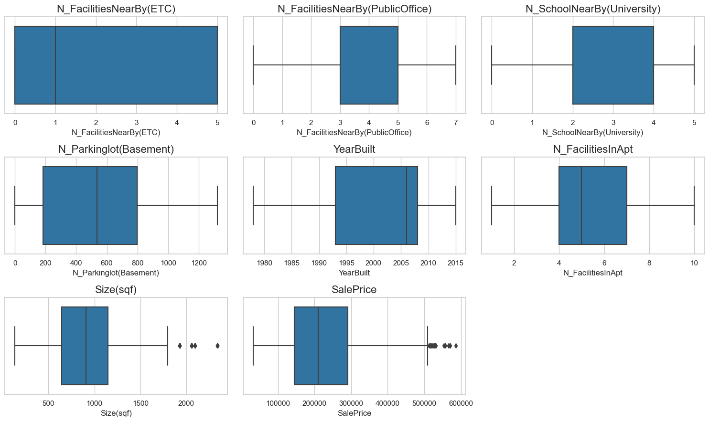
Data Distribution
All numerical variables are not normally distributed.
There are outliers in Size(sqf) and SalePrice

Slide 9
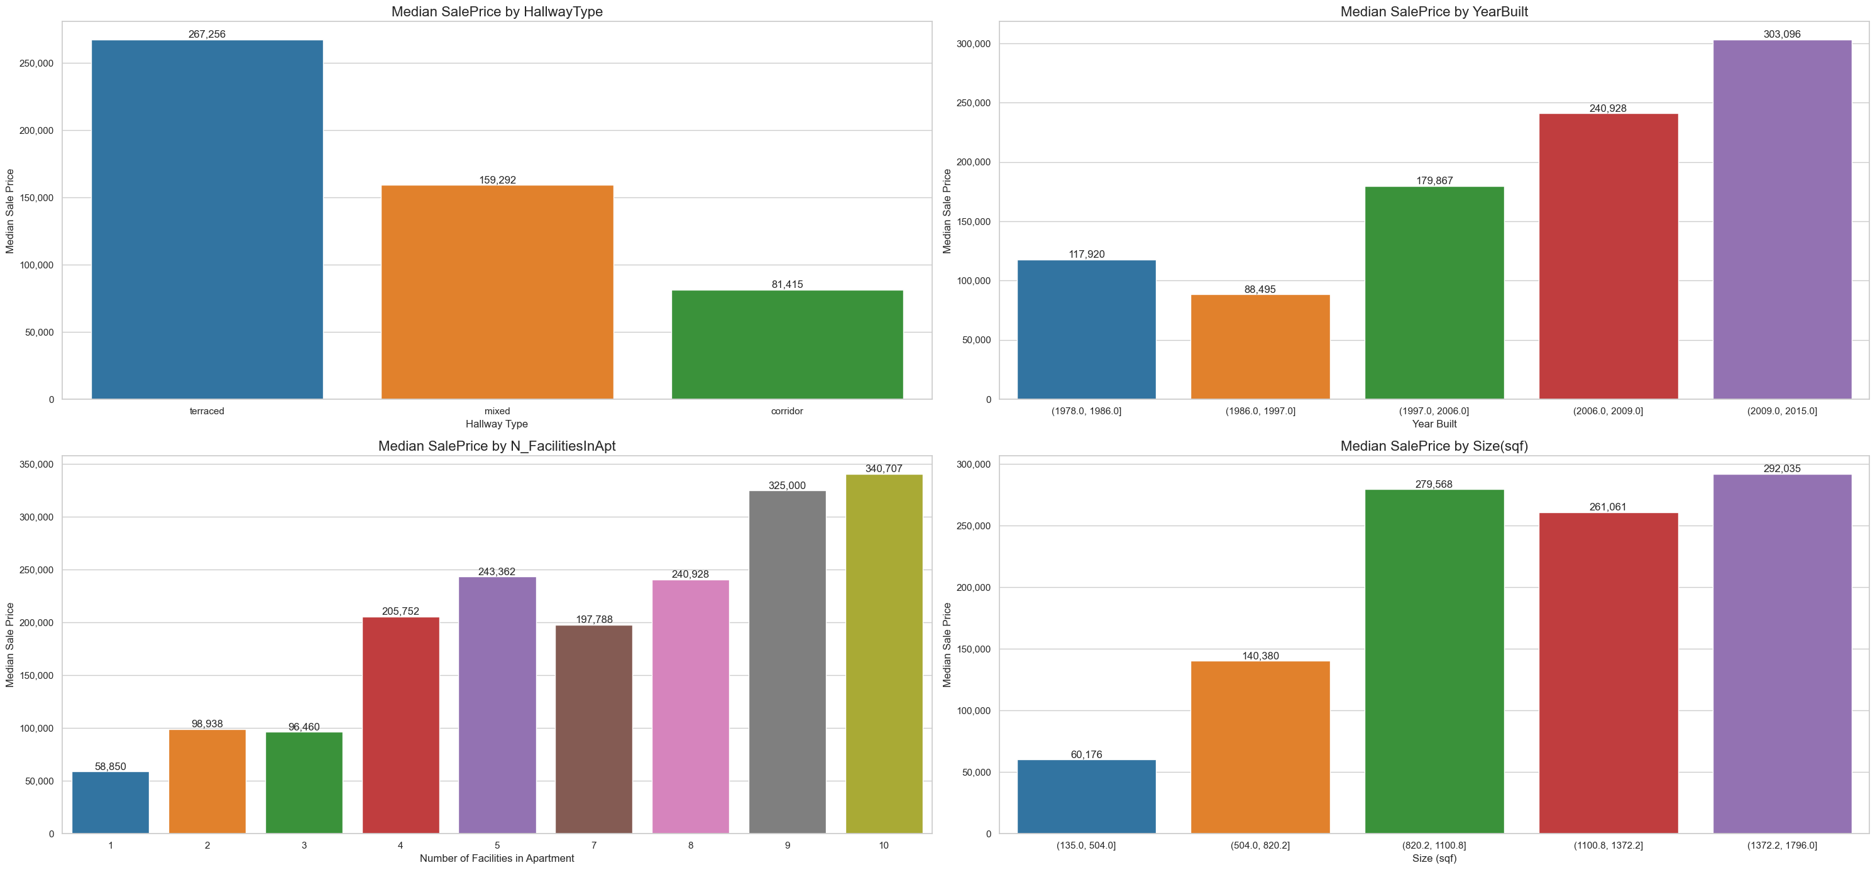
Data Relationship

Slide 10
Data Preprocessing

Slide 11
Missing Values, Duplicates, and Outliers
Handle missing values
There are no missing values in our data set
Handle duplicates
There are 1,422 duplicates
Measure : Remove duplicates
Before : 4,213 rows
After : 2,607 rows
Handle outliers
Size (sqf) : 3.11% of total data
SalePrice : 0.382% of total data
Measure: Remove outliers

Slide 12
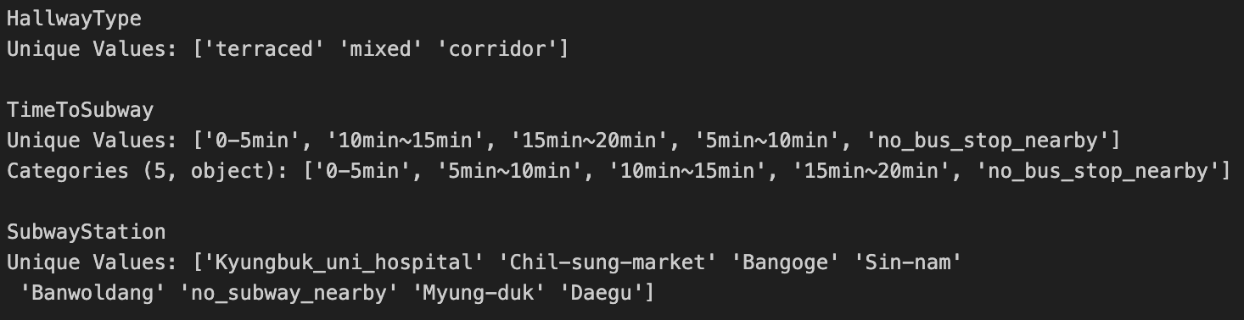
Data Splitting, Encoding, Scaling
Data splitting:
Train set : 80%
Test set : 20%
Encoding:
One-hot : HallwayType
Binary : SubwayStation
Ordinal : TimeToSubway
Scaling:
Robust : All features

Slide 13
Modeling

Slide 14
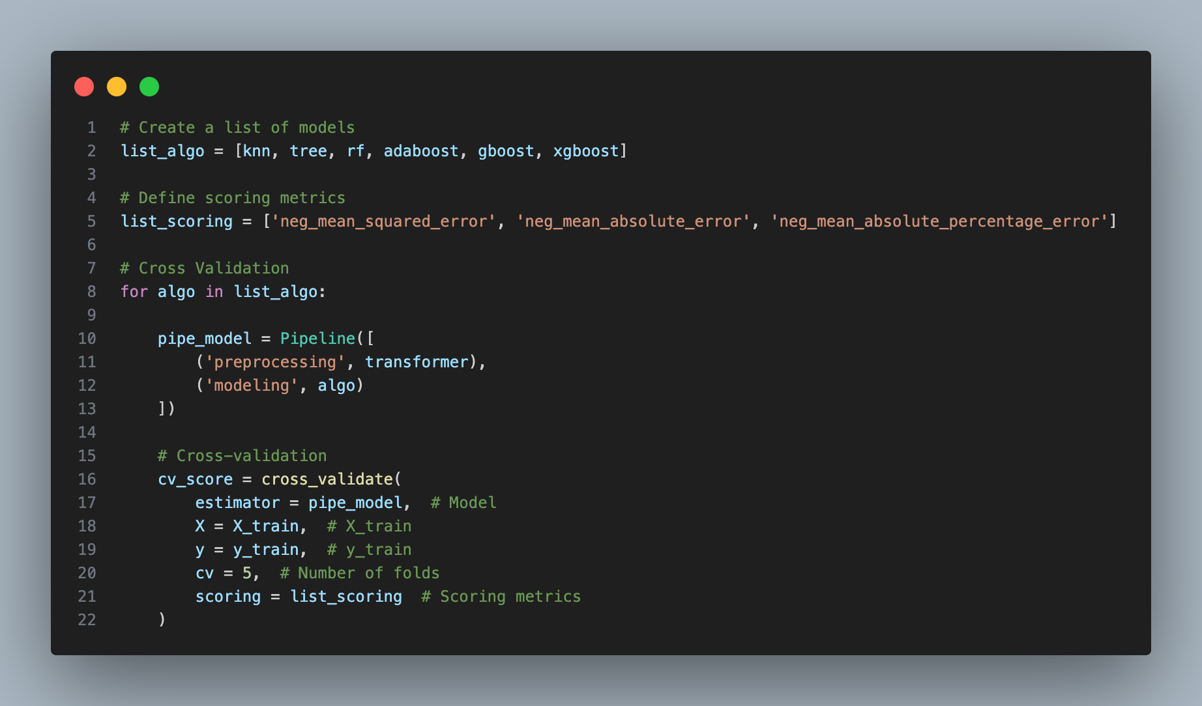
Cross Validation
Search for best algorithm

Slide 15
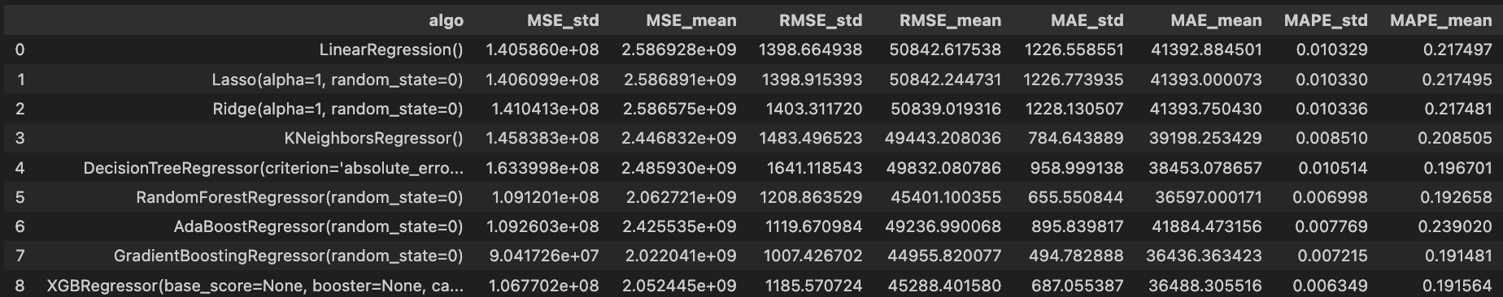
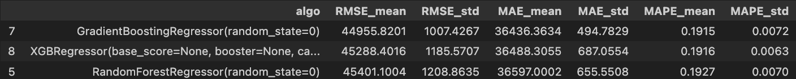
Cross Validation

Slide 16
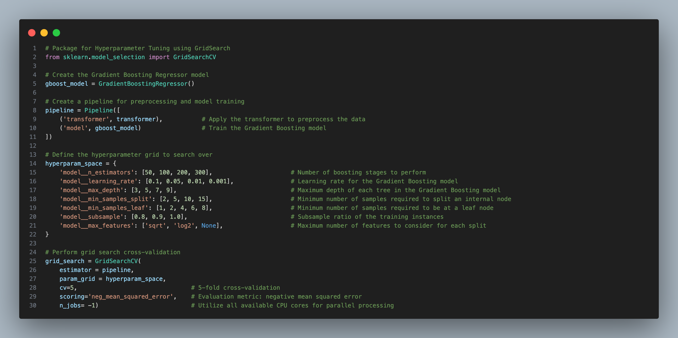
HyperParameter Tuning using GridSearch

Slide 17
Model Best Parameter
'model__learning_rate': 0.1,
'model__max_depth': 3,
'model__max_features': 'sqrt’
'model__min_samples_leaf’: 1
'model__min_samples_split’: 2
'model__n_estimators': 200
'model__subsample': 1.0

Slide 18
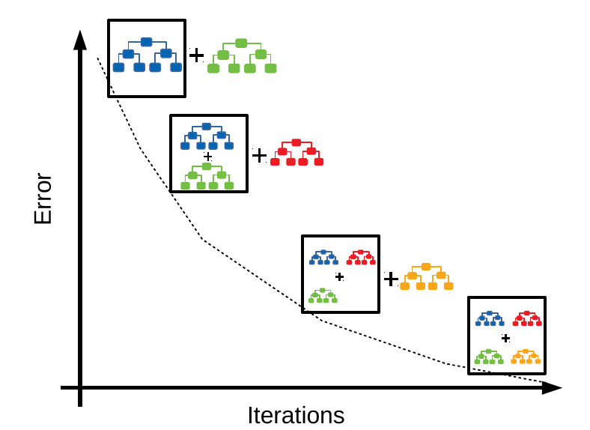
Gradient Boosting Algorithm
Ensemble learning method combining multiple weak models.
Sequentially adds models to correct previous mistakes.
Models trained to minimize errors/residuals of previous models.
Captures complex relationships in the data.

Slide 19
Model Evaluation

Slide 20
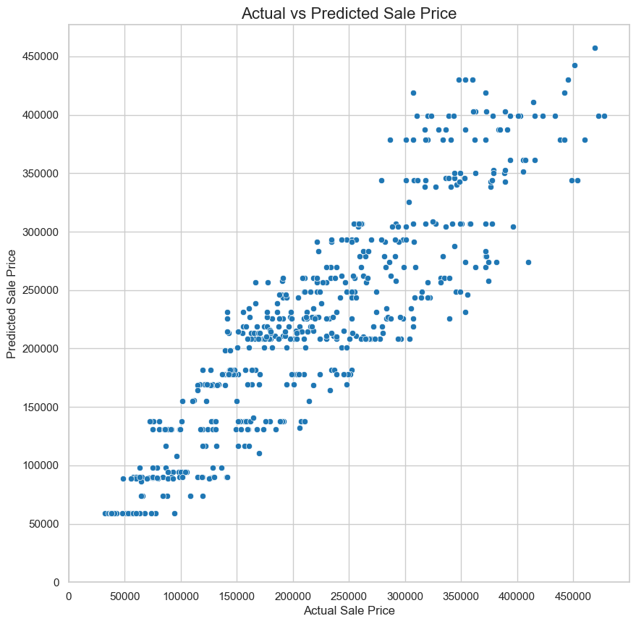
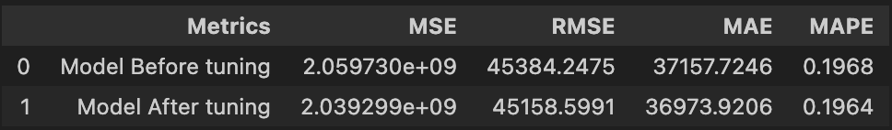
Model Performance in Test Set and Evaluation Metrics

Slide 21
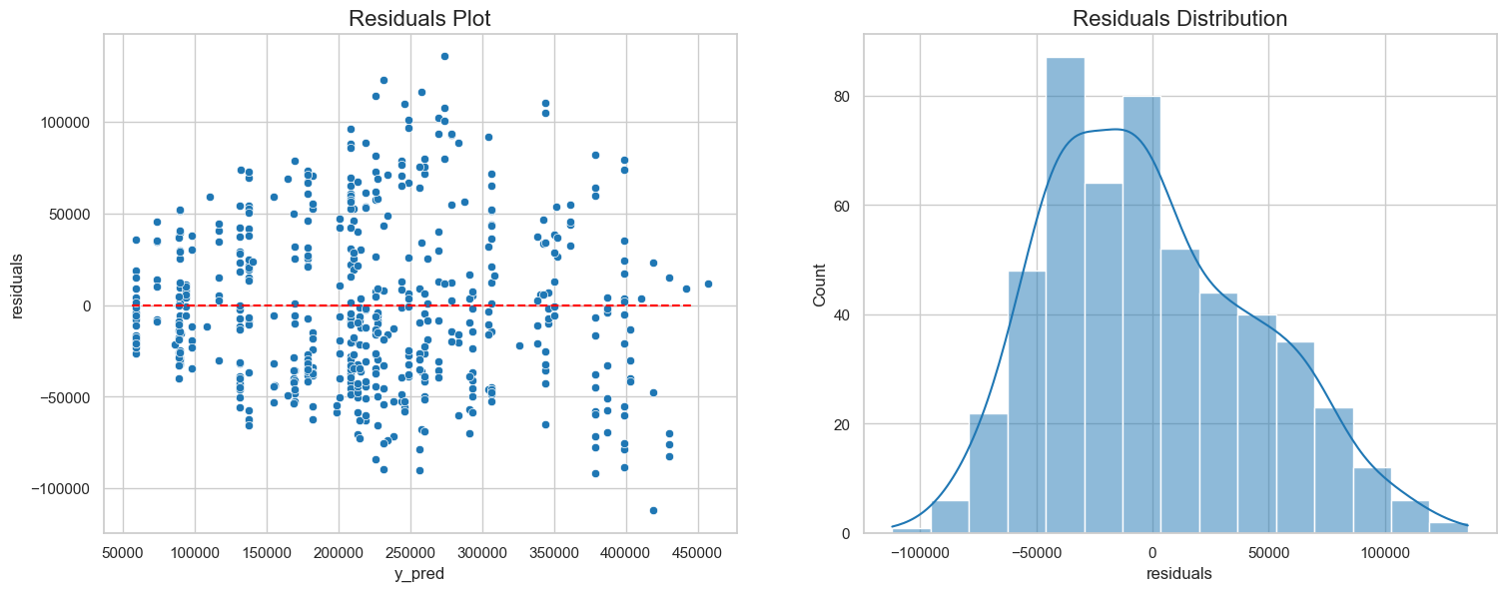
Residuals

Slide 22
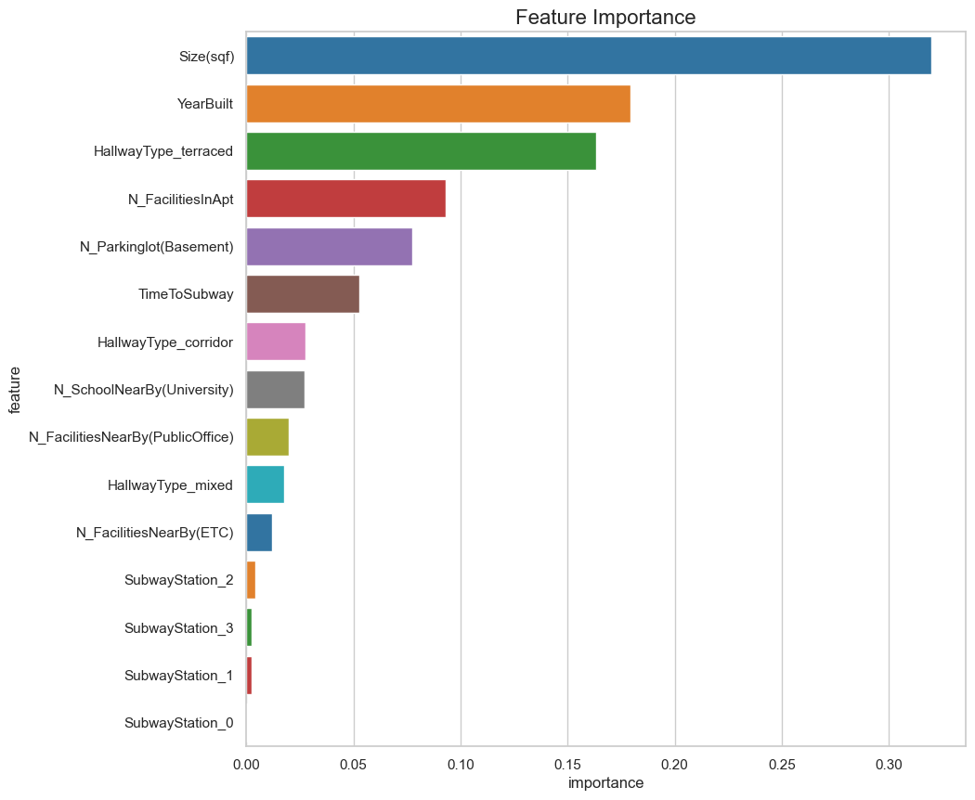
Feature Importance
Size(sqf) and YearBuilt are highly influential in predicting prices.
HallwayType_terraced and N_FacilitiesInApt significantly impact predictions.
Basement parking availability plays a role in price determination.
Inline with EDA

Slide 23
Conclusion
Executed essential steps to develop a predictive model for apartment sale prices.
Utilized Gradient Boosting algorithm, outperforming other algorithms.
Achieved promising performance: RMSE of 45158.5991, MAE of 36973.9206, and MAPE of 0.1964.
Size (sqf) identified as the most influential feature on apartment prices.
YearBuilt and HallwayType_terraced also significant determinants of price.
Model performs better for lower-priced apartments but shows limitations for higher-priced units.

Slide 24
Recommendations
Focus on Size: Consider the size of properties as it strongly influences sale prices
Consider YearBuilt: Newer properties may have higher value due to modern amenities and standards
Hallway Type Matters: Hallway design can impact perceived value, so choose wisely
Account for Price Deviation: Be aware of potential price deviations and set realistic expectations.
Market Segmentation: Tailor marketing strategies to specific customer segments.
Ongoing Evaluation and Refinement: Continuously update and improve the model with new data and feedback.

